Slide 1
Asset Tracking Using LoRa Technology

Slide 2
Problem statement
Keeping a track of one’s tangible assets and to monitor its real time status.

Slide 3
Abstract
Assets in general are essentially any entity that an individual or an organisation considers valuable or useful. An asset could be physical, digital or even emotional.
Asset tracking or management is the process of keeping track of your physical assets and their information (location, status, due dates, etc.)
Traditionally, Asset management could be done using cellular or satellite networks.
Asset Management through IoT has gained popularity in recent times and is preferred over past techniques.
The increasing availability of new technologies—such as low-power wide-area networks (LPWANs)—asset-tracking applications are becoming more ubiquitous and sophisticated.
We are now able to communicate not only the position of the asset but also key information, such as the status of the object and data, such as temperature, speed and asset-specific information.

Slide 4
Literature Survey
LoRa fills a technology gap
LoRa Technology has revolutionized IoT by enabling data communication over a long range while using very little power. When connected to a non-cellular LoRaWAN network, LoRa devices accommodate a vast range of IoT applications by transmitting packets with important information. LoRaWAN fills the technology gap of Cellular and Wi-Fi/BLE based networks that require either high bandwidth or high power, or have a limited range or inability to penetrate deep indoor environments. In effect, LoRa Technology is flexible for rural or indoor use cases in smart cities, smart homes and buildings, smart agriculture, smart metering, and smart supply chain and logistics.
Filling the 5G gap
While 5G was designed to bring faster speeds and connectivity, LoRa devices and the LoRaWAN protocol serve distinct use cases where devices need to be battery-operated and last in the field

Slide 5
extended periods of time. The LoRaWAN protocol has a communication range reaching more than six miles, which is further than 5G’s mmWave variant. While 5G may be optimal for video calls or ultra-low latency applications, LoRaWAN is ideal for water and gas metering, asset tracking and many more applications where low power consumption and long range are required. In addition to LoRa devices’ long range capabilities, it has the power to penetrate physical structures where 5G signals cannot.
LoRa complements Wi-Fi, Bluetooth and Cellular
Like Wi-Fi, LoRaWAN operates in the unlicensed band and supports indoor applications; like Cellular, LoRa Technology is highly secure from end devices to the application server, and is suitable for outdoor applications. LoRa devices and the LoRaWAN protocol combine these features of Wi-Fi and Cellular networks to offer an efficient, flexible and economical connectivity solution ideal for IoT applications whether indoor or outdoor and installed in public, private or hybrid networks. Simple sensor data can fuel analytics platforms, such as those for artificial intelligence and machine learning. These require data diversity which is made possible by low-cost LoRa-enabled sensors.

Slide 6
Objective
To develop a low power device using LoRaWAN standard which is open and freely available to communicate for a long range of 2Km to 10Km for Asset tracking.

Slide 7
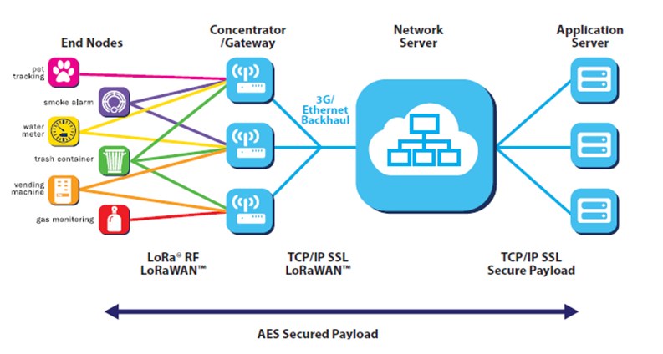
Methodology

Slide 8
Explanation :
End nodes are the end point where the asset is connected with the sensors and the chip set design for the designed usage.The chip set then transfers the data to the gateway through multiple LoRa communication channels.The gate way then filters all the identical data and push the data further with the help of internet to the network server.Now the data can be extracted from the network server and added to the application server where the user can manage the asset data or the simply monitor there asset.The communication is bidirectional, the application server can send an acknowledgement to the end node through the optimised path.

Slide 9
Hardware and Software used
Hardware
Raspberry pi 4B
STM32L552ZE
Arduino nano 33 IOT
RFM95
Antenna
Sensors
Temperature sensor
GPS module
Humidity sensor
Software
Raspberry pi imager
Arduino IDE
STM32 cube IDE

Slide 10
Thank You
Seema Rathod
Sneha Dhanan
Shivam Choudhary
S Sri Harsha

